Slide 1
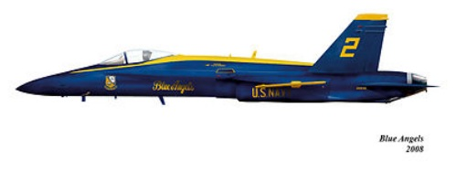
Final Project: Similar Triangles and Models
By: Clarisa Rosario
MTH 4040 Coordinating Seminar

Slide 2
Lesson
Overview
Objective
The students will understand the use of scaling in order to approximate the measurements of a similar object.
The students will know how to find the missing side of a similar triangle (given the measurements of a model).
Goals
Given a model of an object and a worksheet, the student will calculate and record the approximate measurement(s) of a life-size similar object answering all given questions.
Given a diagram, the student will calculate the length of an object using scaling and similar triangles within 4 units of accuracy.
Objectives

Slide 3
NCTM and Common Core Standards Addressed
NCTM Geometry Standards
In grades 6–8 all students should:
draw geometric objects with specified properties, such as side lengths or angle measures;
recognize and apply geometric ideas and relationships in areas outside the mathematics classroom, such as art, science, and everyday life.
Common Core Math Standards
CCSS.Math.Content.7.G.A.2
The student will:
Draw (freehand, with ruler and protractor, and with technology) geometric shapes with given conditions.
Focus on constructing triangles from three measures of angles or sides, noticing when the conditions determine a unique triangle, more than one triangle, or no triangle.

Slide 4
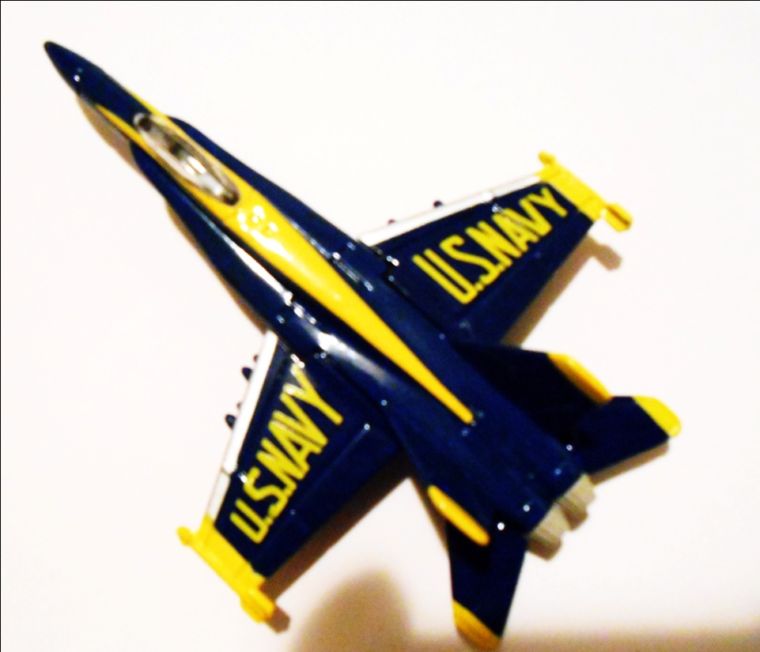
Introduction
Insert Picture
Lesson “Hook” – The Flight of the F/A-18
This is a 2-minute video that shows one of the real Blue Angels in flight.
The Problem:
Here is a scale model of a real airplane, the F/A-18 Hornet, used by the U.S. Navy’s iconic Blue Angels. The wingspan of the real aircraft is 40 feet. By measuring the dimensions of the model, determine the length of the actual aircraft. Restriction: You may not measure the length of the model with a ruler.
What is the scale of the model to the real thing?

Slide 5
Predicting
Organizing Students’ Thoughts
On their handouts, students will have a section to fill out that allows them to organize their thoughts and create a prediction about how much bigger the real plane will be than the model plane.
What information is given? | The wingspan of the actual aircraft (width of the plane)
What am I looking for? | The length of the real aircraft from the nose (front tip) to the rear wings without using a ruler
Prediction of scale: How many times bigger do you predict the actual plane will be compared to the model? | Students’ answers will vary. Example: The actual plane might be 100 times bigger than the model.

Slide 6
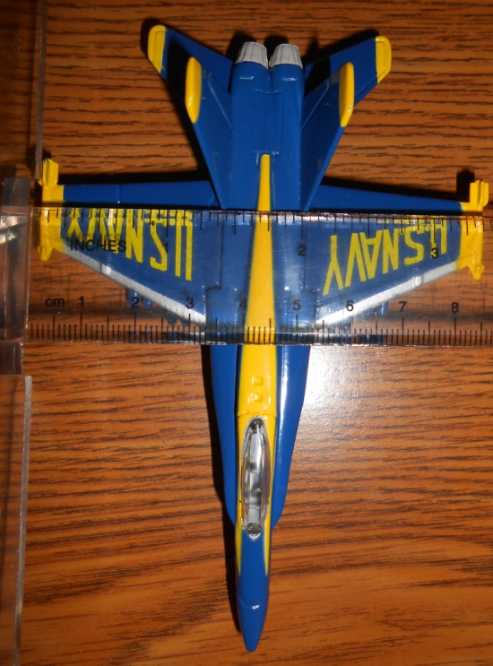
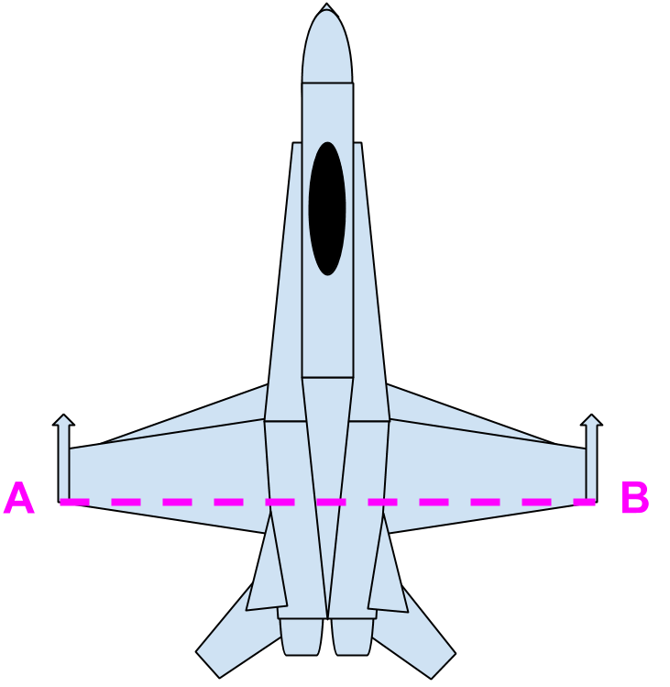
Investigation
Phase I: Investigation
Students will start by measuring the wingspan of the model plane (width of the model).
They will mark the points A and B on the diagram provided and write in the length (in inches) in the space provided.
The model’s wingspan AB is 3 ½ inches.

Slide 7
Investigation (con’d)
Students will have focusing questions to answer to help facilitate their understanding of the content.
How does having the wingspan of the model airplane help? | With the width, we can try to find the length of the model. Once we have the length of the model, we can find the length of the real plane using a proportion.
What else could help us find the length of the model? | If we form a triangle with the tip of the plane, we can get the length of side AC and BC (which will be the same length due to the symmetry of the plane).

Slide 8
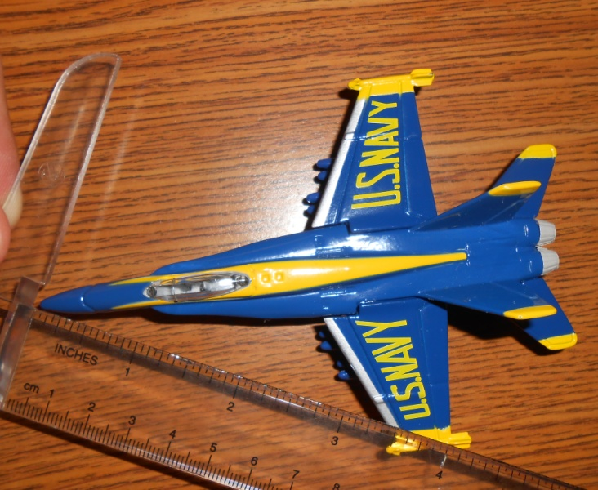
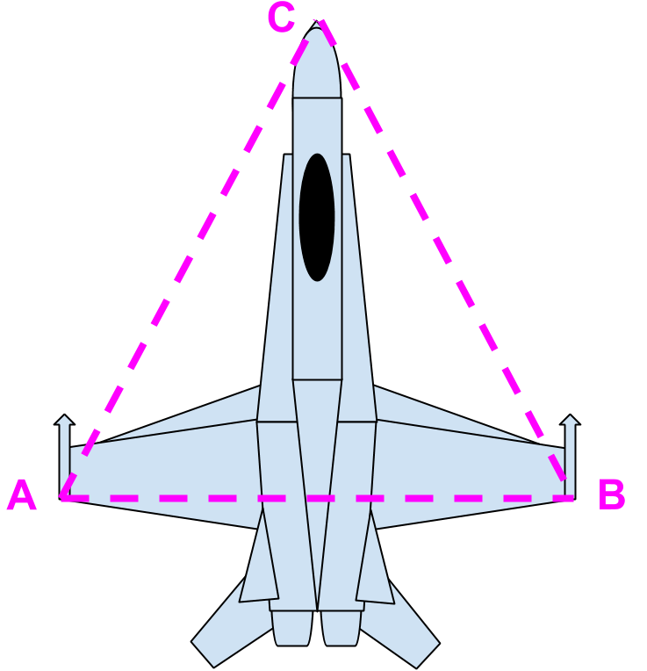
Investigation (con’d)
Students create a triangle by connecting the tip of the plane to the points A and B (and label this new point C).
Students need to figure out a way to incorporate the whole length of the airplane (rather than just from point C to the wing). What can students do to include the entire length of the model (extend the sides of the triangle to the rear wing tips).
The length of AC can now be obtained. AC ≈ 4 ¼ inches.

Slide 9
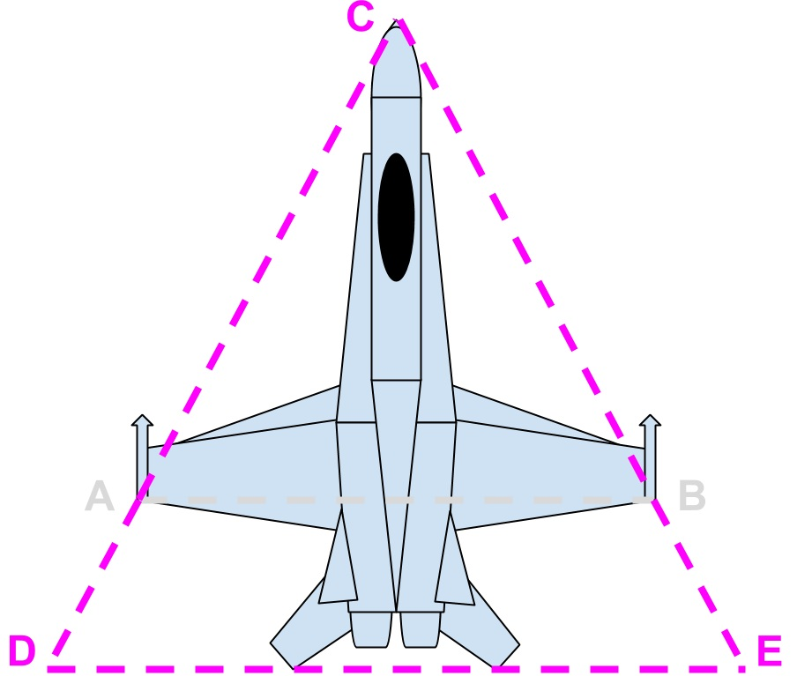
Exploration
As students see similar triangles formed (ACB and DCE), I give students the next piece of information - the length of DE (students do not have the prerequisite knowledge to find this measurement).
As students continue to work with the information, they realize that they can now obtain the length of DC.
The length of DE ≈ 4.75 inches.

Slide 10
Exploration (con’d)
I will ask students to answer these questions in their handouts:
What assumptions can be made about lines AB and DE based on the symmetry of the aircraft? | Since the plane is symmetrical, we can assume that AB and DE are parallel.
It is important to guide the students – let them make a mistake and see where it gets them. I (the teacher) may be looking for a certain answer, but students learn through error too.
How can we use the properties of similar triangles to help us solve for the length of DC? | We can set up the proportion: AB/DE = AC/DC Therefore, DC = (DE*AC)/AB
DC is approximately 5.76 in.

Slide 11
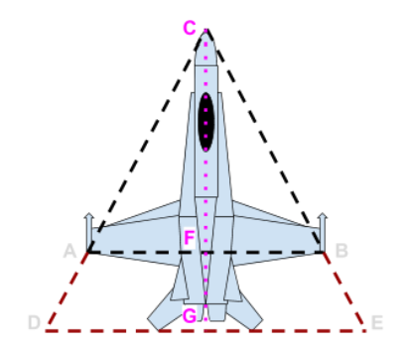
Discovery
Another question to consider:
Now that we know the lengths of our “outer triangle”, what can we do to find the length of the model plane? | We can bisect angle DCE, drawing a line straight down to line DE. This line is a perpendicular bisector of lines AB and DE.
I will have students label the point G at the base of the plane. We are on our way to finding the length CG!
We know DC and DG. Students will use the Pythagorean Theorem to find the length of CG.

Slide 12
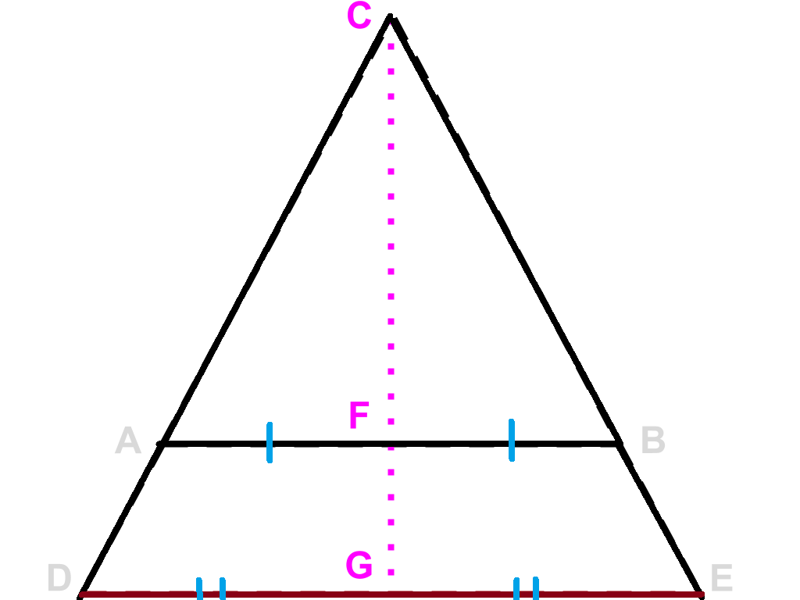
Discovery (con’d)
Since the CG is a perpendicular bisector of DE, what does that tell us about the length from point D to G? | ___________________________________ ___________________________________ ___________________________________
Also, now that we have DG and DC, how will we obtain the length of CG? | ___________________________________ ___________________________________

Slide 13
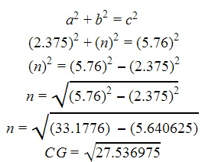
Discovery (con’d)
Finding the length of CG (length of the model plane):
Pythagorean Theorem
DG ≈ 2.375 inches
CG = n
DC ≈ 4 ½ inches
CG ≈ 5.247 in

Slide 14
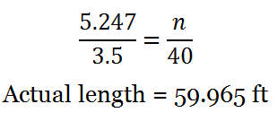
Discovery (con’d)
Finding the length of the real aircraft – Set up the proportion!

Slide 15
Optional Lesson Reflection
Look back at your scale prediction – were you over or under? | Answers will vary.
What importance does a model have when considering building a large-scale object? | Using a model allows builders to preview how an object will look once it is built so they can build efficiently and try to forsee any problems.
What kinds of problems do you foresee by rounding the inches to the nearest 1/4th inch? Can you think of a more accurate way for people to create a scale model of an object? | One of the problems with rounding is that with each measurement, the calculations become more and more inaccurate. A better way might be to use 3D technology to render a model.

Slide 16
Afterthought:
Upgrade your lesson to high school level by introducing Law of Sines to help solve this problem.
Geometry Standard:
Apply trigonometry to general triangles – Understand and apply the Law of Sines and Law of Cosines to find unknown measurements in right and non-right triangles (e.g. surveying problems, resultant forces)

Slide 17
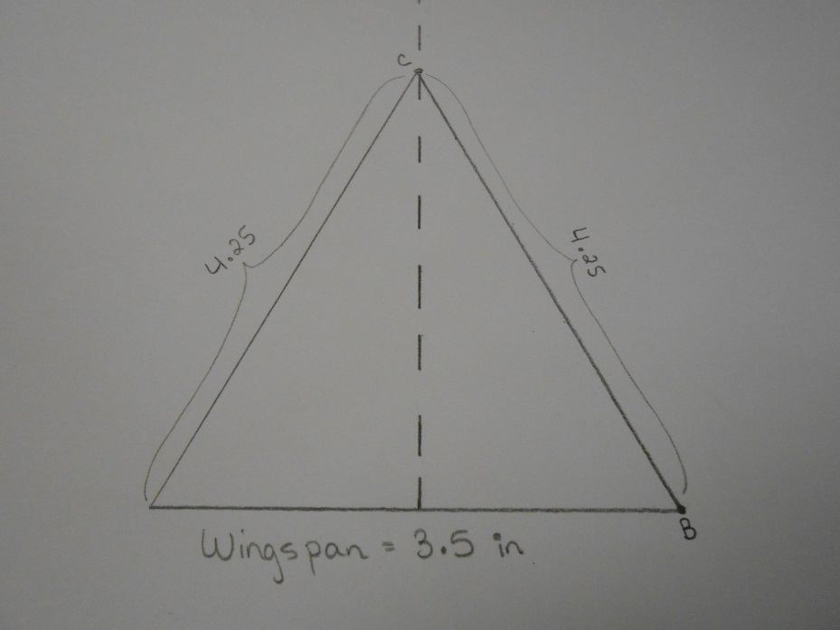
Afterthought (con’d)
Directions:
Have students use their rulers and draw the 3.5 in line from A to B and label it.
When students realize they can use a triangle, have them find the middle of AB, extend a line vertically, then measure a triangle with the side lengths 4.25in.

Slide 18
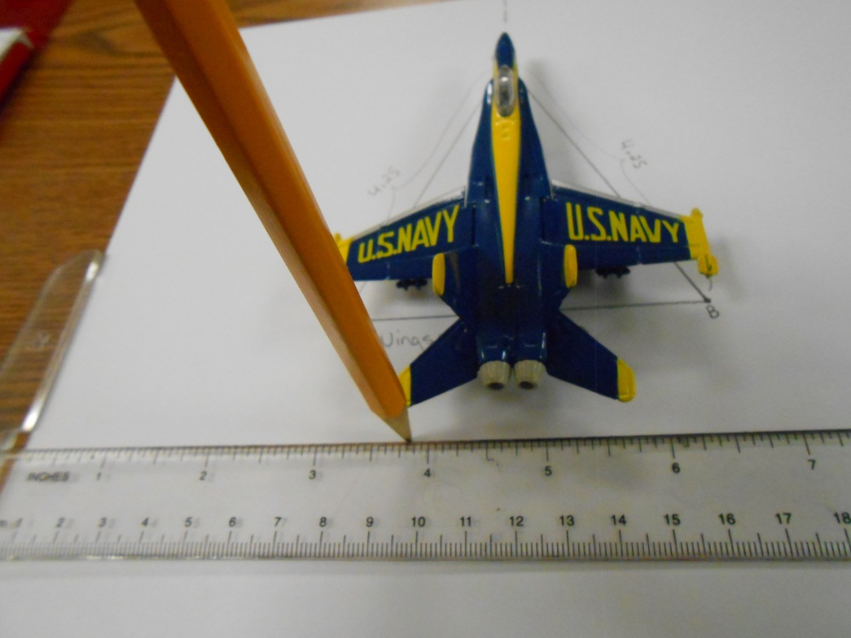
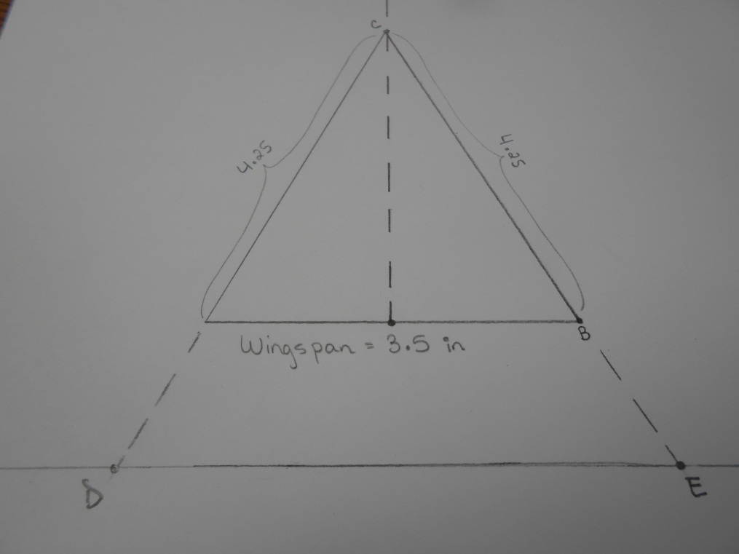
Afterthought (con’d)
Directions:
Students will extend the sides of the triangle. DE will not be given, but students can find it by using the actual model and carefully marking the horizontal line that follows the wing’s tips as seen in the picture below.

Slide 19
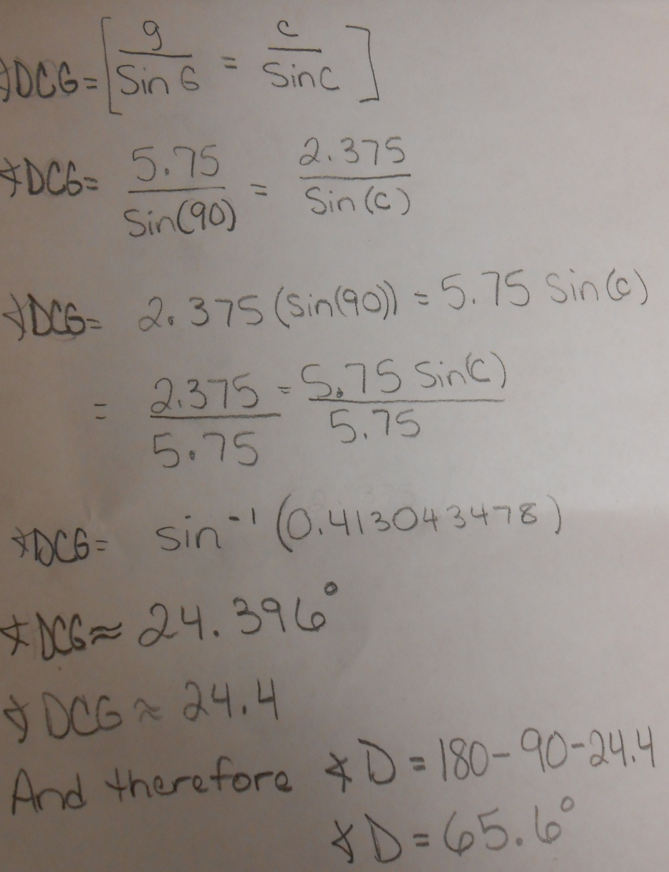
Afterthought (con’d)
Directions:
Students will use the Law of Sines to find angle DCG (note that angle DCG is half of angle C). [Also note to students that we have SSA.] Then they will use properties of a triangle (angles total 180 degrees) to find the missing angle D.

Slide 20
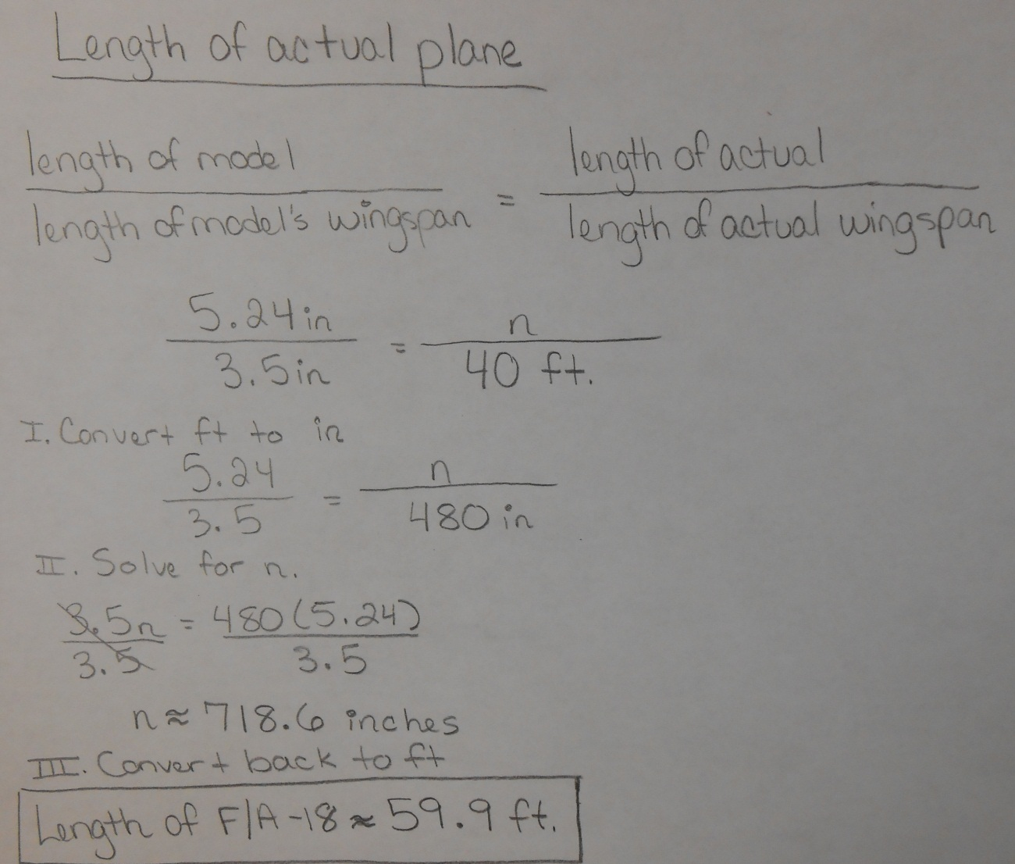
Afterthought (con’d)
Directions:
Finally, students will use the Law of Sines once more to find the length of the model plane.
They will set up a proportion to solve for the length of the real plane.

Slide 21
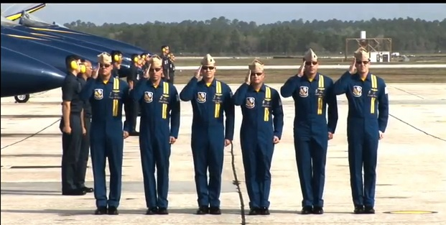
References
Slide 1 – Picture of F/A-Hornet
http://en.wikipedia.org/wiki/McDonnell_Douglas_F/A-18_Hornet#Specifications_.28F.2FA-18C.2FD.29
Slide 2 – Picture of NASCAR Dale Jarrett #88 UPS 2001
http://nowandthencollectibles.com/catalog/images/Winners%20Circle%201-24%20scale%20029.jpg
Slide 4 – Anticipatory Set
ZR1 Vette vs Jet! - Chevrolet Corvette ZR1 Races A U.S. Navy Fighter Jet
http://www.youtube.com/watch?v=6muw6pqzk_c
Bloom’s Taxonomy Criteria
http://www.google.com/imgres?imgurl=http://ww2.odu.edu/educ/roverbau/Bloom/fx_Bloom_New.jpg&imgrefurl=http://www.odu.edu/educ/roverbau/Bloom/blooms_taxonomy.htm&h=243&w=281&sz=9&tbnid=waefmcADfSviFM:&tbnh=90&tbnw=104&prev=/search%3Fq%3Dbloom%27s%2Btaxonomy%26tbm%3Disch%26tbo%3Du&zoom=1&q=bloom%27s+taxonomy&usg=__tSHVRq4-P3WR315CwBeInwNN2Cw=&hl=en&sa=X&ei=xj1_UZ6kKpes4AOG_YDICw&ved=0CDQQ9QEwBA

